Slide 1
Light Intensity Controlled Automatic Curtains with Voice Recognition

Slide 2
Contents-
Scope
Required Hardware and Software
Plan of Action
Division of Work
Resource Arrangement, Feasibility

Slide 3
Division of Work
Keshav Garg
Coordination, Circuits and Calculations
Aditya Chandrikapure
Hardware and Assembly
Karan Nag
Software(Code of the project)
Shelly Aggarwal
Circuits, Research Work and Mechanical Parts Assembly
Akshat Chaudhary
Presentation, Lab Report and Calculations

Slide 4
Working of Curtains
Opening of Curtains
The servo motor(s) will open the curtains accordingly to different levels.
03
Light Level Input
Light levels will be recorded in the circuit through a photoresistor and saved for processing
01
02
Processing
The recorded light levels(or voice commands) will be given to the servo motor

Slide 5
Scope
PRINCIPLE-
The light intensity will be recorded continously and the curtains will be adjusted to particular levels to compensate for the light coming through.
The curtains can also be set to voice recognition mode where it can be opened to different levels by voice commands
FINAL OUTPUT-
Curtains will open or close according to the different light levels or given voice commands
APPLICATIONS-
Light level regulation inside the room, easier operation of the curtains with voice commands

Slide 6
Required Hardware and Software
MECHANICAL
Servo Motor
Curtains
Strings
CIRCUIT
Arduino Uno
2 Resistor(1K Ohm)
2 Light Intensity Sensor(Photoresistor)
LEDs
Jumper Wires
Bluetooth HC05
Breadboard

Slide 7
Resource Arrangement-
PARTS
The total cost for our project is Rs 1585 including all the circuit elements and Hardware parts like Servo motor, Strings, etc.
Arrangement of Resources
Resources have been arranged offline or online depending on the circumstances and some of the has been done through online softwares like freecad, tinkercad, Arduino Shell etc.

Slide 8
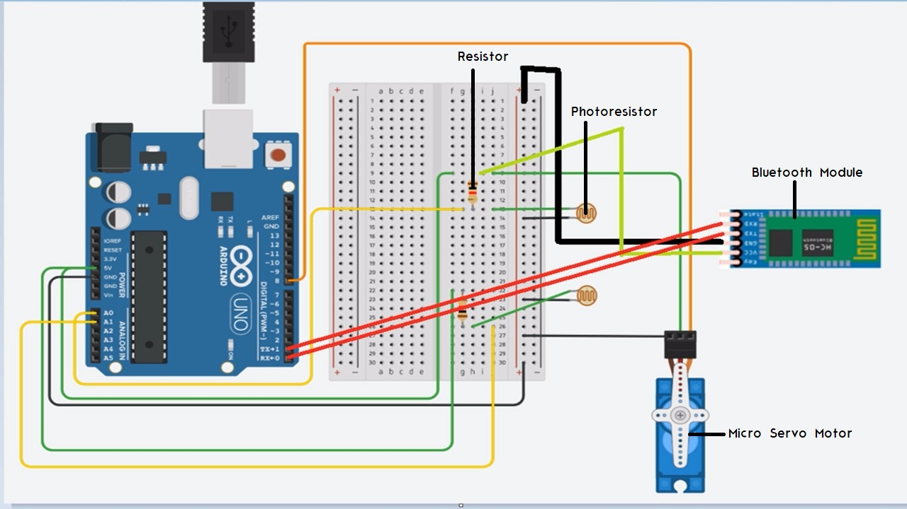
Circuit Diagram

Slide 9
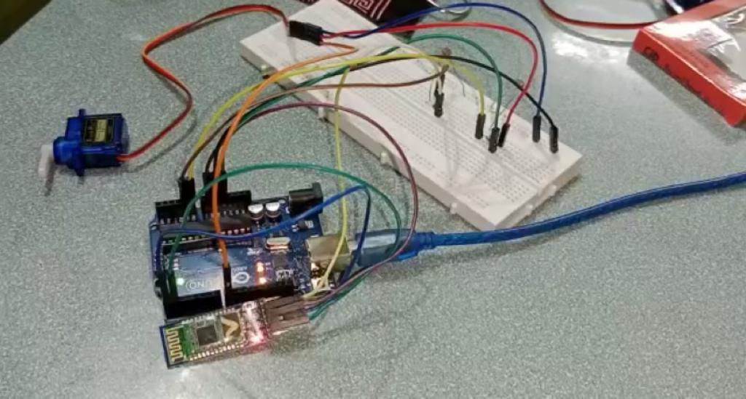
Circuit Assembled

Slide 10
Plan of Action-
INPUT of LIGHT LEVELS
The photoresistor will record light values coming from outside the window
The circuit will continuously record light intensity to adjust the curtains
Voice Commands
The curtains can also be changed to voice recognition mode where we can say commands like open, close or adjust to level 1, 2, 3 etc. to control the curtain level
OUTPUT
Servo motor will open the curtains and adjust them to different levels to regulate the light levels coming in the room.

Slide 11
CHALLENGE-
Now using two photoresistors made the rotation of servo motor dependent on two intensities as measured by the two photoresistors. They could be different most of the time as the light falling on the photoresistors depend on the position and distance of light source too. Directly specifying the intensity would lead to failure of our project as that would create confusion between do different measured values.
For e.g.: In case of a circular light source intensity is inversely proportional to square of the distance.
I ∝ 1/d2

Slide 12
CALCULATIONS-
To solve this challenge, our knowledge of permutations and combinations came handy.
Intensity measured by Photoresistor 1= I1
Intensity measured by Photoresistor 2=I2
We specified four levels at which our curtain would be open so four intensity ranges were decided.
Hence, we had four values of each I1 and I2.
So total combinations that would occur at any given day=4*4=16
The Table of intensities vs servo motor rotation angle (in degrees) is as follows

Slide 13
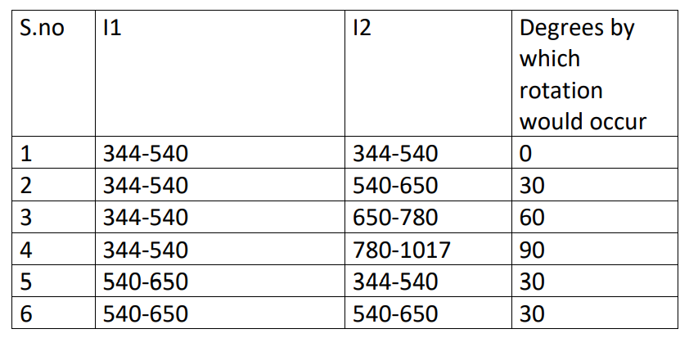
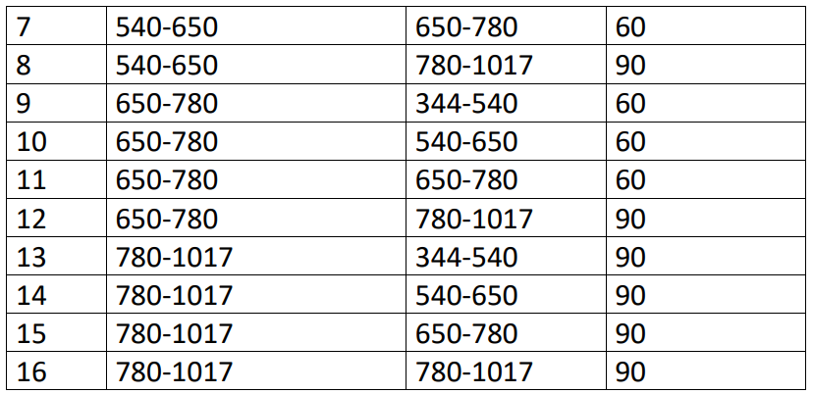

Slide 14
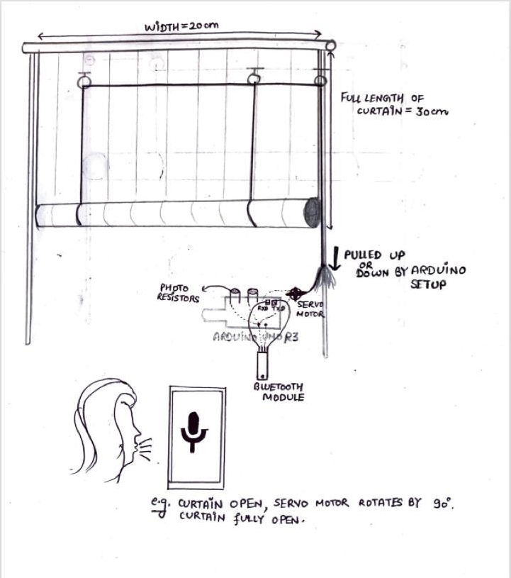
Schematic Diagram

Slide 15
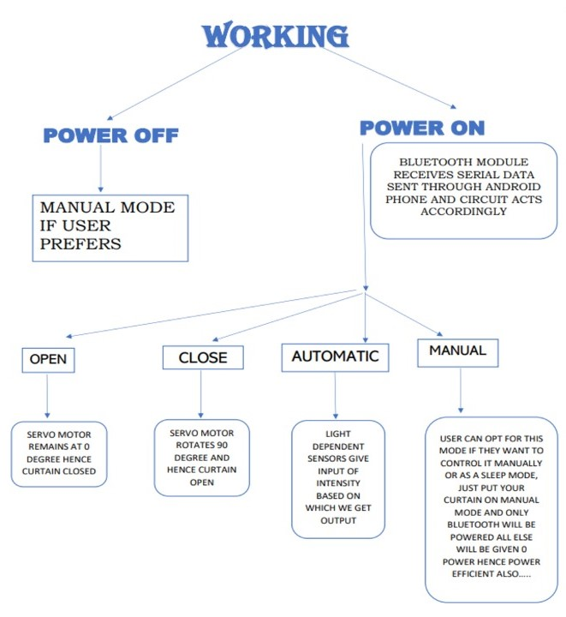

Slide 16
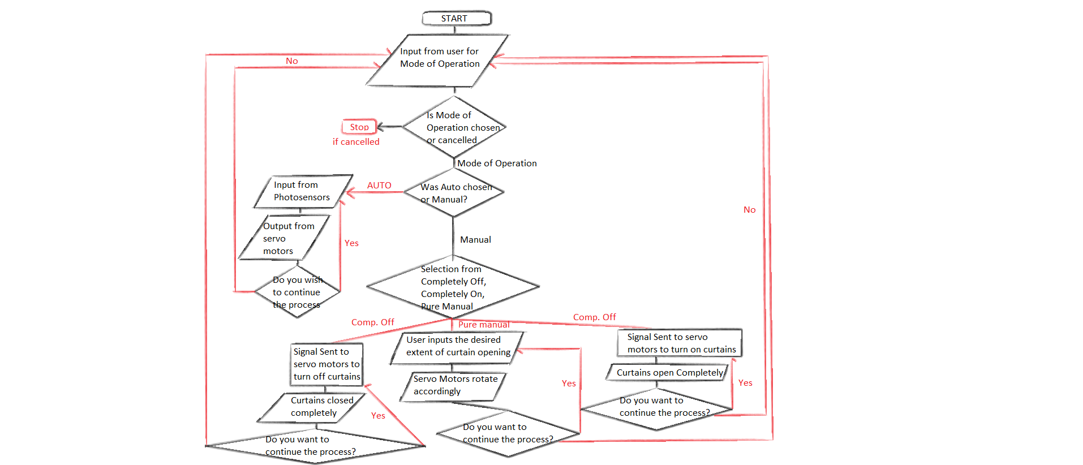
Flowchart about detailed working of curtain :-

Slide 17
THANK YOU

